Slide 1
ENSE 496ab, Milestone 5
!Cool
Team Members:
Christian John
Ahmed Shamiss
Jeremy Cross
Evan Geissler
Taylen Jones
Dakota Fisher
6th December, 2018

Slide 2
Team !Cool
We are team !Cool and and our group members are:
Christian John
Ahmed Shamiss
Jeremy Cross
Evan Geissler
Taylen Jones
Dakota Fisher
We are assigned to the Weekend Warriors project

Slide 3
Usability Evaluation Results
Link to the usability review
https://github.com/OmegaHelix/notcool/tree/master/Usability%20Evaluation/Fall%20Term%202018
Link to combined data
https://github.com/OmegaHelix/notcool/tree/master/Usability%20Evaluation/Fall%20Term%202018/Retrieved%20Data

Slide 4
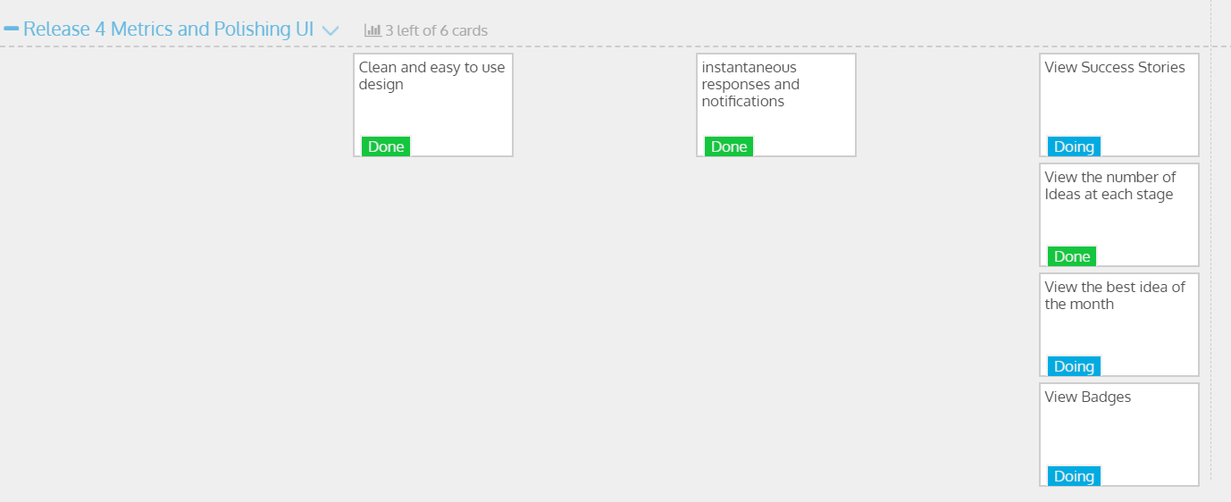
USM Review

Slide 5
DEMO TIME !!!

Slide 6
Documentation
Link to the github
https://github.com/OmegaHelix/notcool

Slide 7
Next Steps, Comments/Discussion
Functionality that we were unable to complete
Gamification
Metrics
Success Stories
Idea of the Month
Our next steps would be to finish these items to completion

Slide 8
Group reflection
How did you feel about this milestone? What did you like about it? What did you dislike?
Overall successful, Some problems put us behind.
Liked the end result of milestone
Disliked
What did you learn about yourself as you collaborated and worked through this milestone?
Better understanding of ASP.net so more comfortable with it now.
ASP.net sorta kinda sucks now

Slide 9
Group reflection
How will you use what you have learned going forward?
Hopefully be able to use knowledge learned to create better ASP.net applications in the industry
What “stuff & things” related to this milestone would you want help with?
Nothing in particular

Slide 10
Questions?

